Slide 1
Analysis of Farmer Queries Data
By Team 25 (Bhaswath,Abhijeeth,Surya,Sukesh)

Slide 2
Project and Data Overview
Kisan Call Centers are storing huge amounts of data, where the data contains the queries asked by the farmers and the responses given by Kisan Call Center operators.
With many queries being asked every day, it amounted to massive data. The dataset contains the following columns :
Season , Sector , Category , Crop , Query Type , State Name , District Name , Block Name

Slide 3
PreProcessing Techniques used
Data Cleaning
Feature Splitting
Subset Selection
Discretization
Sampling
Data Analysis Techniques used
Association Rule Mining
Decision Tree

Slide 4
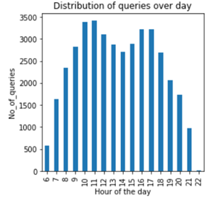
Visualizations
Geo Visualization
Queries at different times of a day

Slide 5
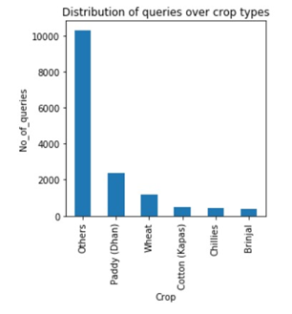
Frequeny of CropType :

Slide 6
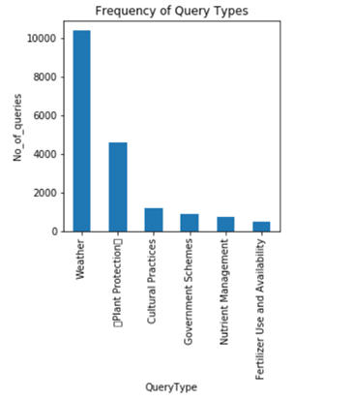
Frequency of QueryType :

Slide 7
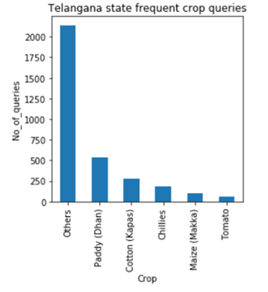
Telangana state frequent crop types:

Slide 8
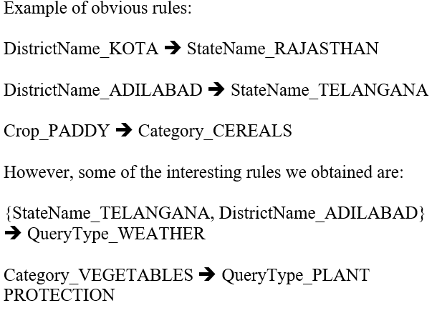
Rules from Association Rule Mining

Slide 9
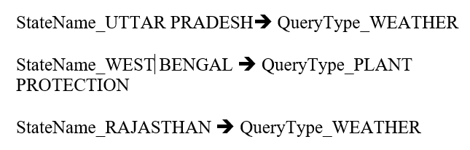
Rules from Association Rule Mining

Slide 10
DECISION TREE CLASSIFICATION
Classification is a process of categorizing a given set of data into classes.
Here we used classification to predict Type of Query from Sector, Crop, Category, Location and Hour of Day attributes.
Accuracy of model around 57%.

Slide 11
THANK YOU!

